Slide 1
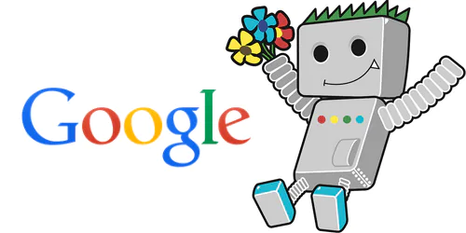
Googlebot a perfect implementation of BFS.
Shrey Gahlawat
Discrete Mathematics CS 131

Slide 2
GOOGLEBOT
Googlebot is a special type of software, also referred to as a spider, designed to crawl its way through the pages of public websites.
It follows a series of links starting from one page to the next, and then processes the data it finds into a collective index.
This software allows Google to compile over 1 million GB of information in only a fraction of a second.
Online search results are then pulled directly from this index. An easy way to think of it is as a library with an ever-expanding inventory.
Googlebot is a generic term for the tools it uses to discover web content in both desktop and mobile settings.

Slide 3

SOME IMPORTANT POINTS
Web crawlers :-It is an Internet bot that systematically browses the World Wide Web, operated by search engines for the Web indexing to make them optimize .
Seeds :- Googlebot uses BFS, starting on high quality web pages, called seeds, and explore all links on these pages.
Frontiers:- As the web crawler proceeds, it adds the URLs of all links on the new pages it visits, adding them to the crawl frontier.
Website crawlability:- Crawlability refers to the degree of access Googlebot has to your entire site. The easier it is for the software to shift through your content, the better your performance.
SEO- Search engine optimization:- The process of making your site better for search engines. In other words after search engine optimization our website is on the top of the Google's search engine.

Slide 4
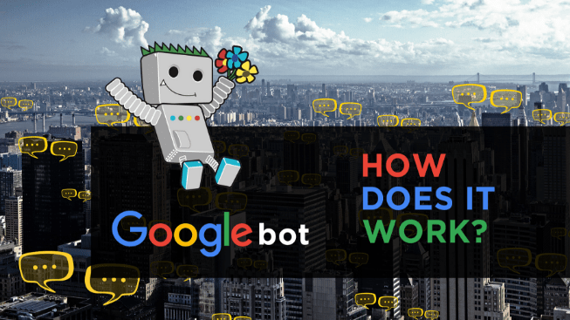
HOW IT WORKS
Google gets information from many different sources, like:
Web pages
User-submitted content such as your Business Profile and Google Maps user submissions
Book scanning
Public databases on the internet
Many other sources………
However, this page focuses on web pages. Google follows three basic steps to generate results from web pages:
Crawling
Indexing
Ranking

Slide 5
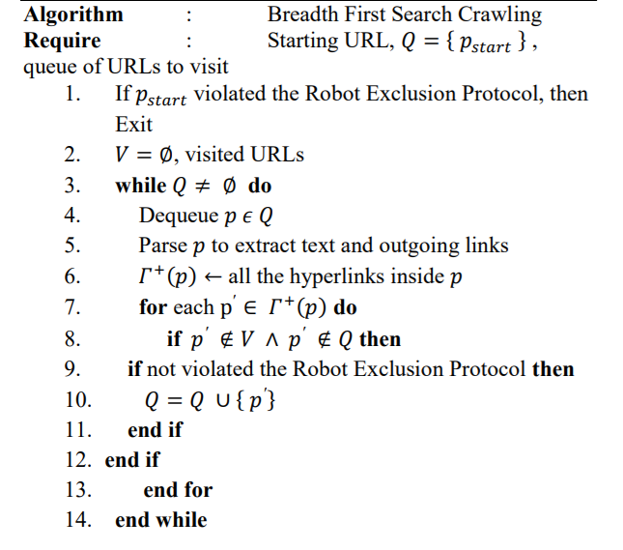
ALGORITHM USING BFS
Source code: google

Slide 6
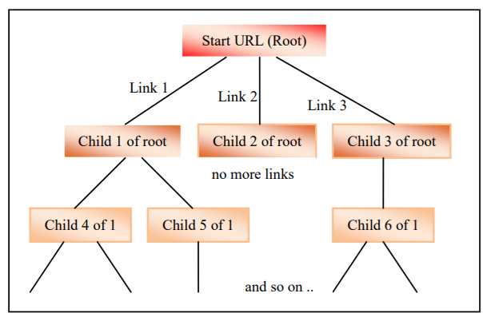
IMPLEMENTATION
Start from URL
Then visited link 1,2,3
Then again visited the child’s of link 1.2.3
An so on till the end .
After implementing the BFS the QUEUE becomes:
URL Link1 Link2 Link3 Link5 Link6 Link9 ………..
IMPLEMENTATION
URL | Link1 | Link2 | Link3 | Link5 | Link6 | Link9

Slide 7
CONCLUSION
A Googlebot is Google's web crawling bot, also known as a spider or web robot. It is a program or automated script browsing the Internet globally in a methodical manner to provide up-to-date data. Web crawling is where a Googlebot finds new and updated pages to be included in Google's indexing. This will really help us to promote our website ,to pull out more clients on the web pages, increase the sales of your products and businesses. So the Googlebot can be implemented by web crawling using BFS.

Slide 8


